Slide 1
Software II
By: Gadaguer Leon

Slide 2
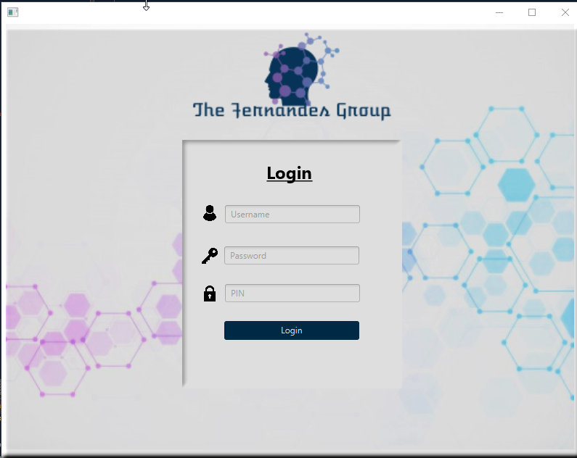
Login Form
This is the initial login form without any input
Authentication credentials are as follow:
Counselor 1
Username: admin
Password: admin
PIN: 1234
Counselor 2
Username: admin2
Password: admin2
PIN: 1234

Slide 3
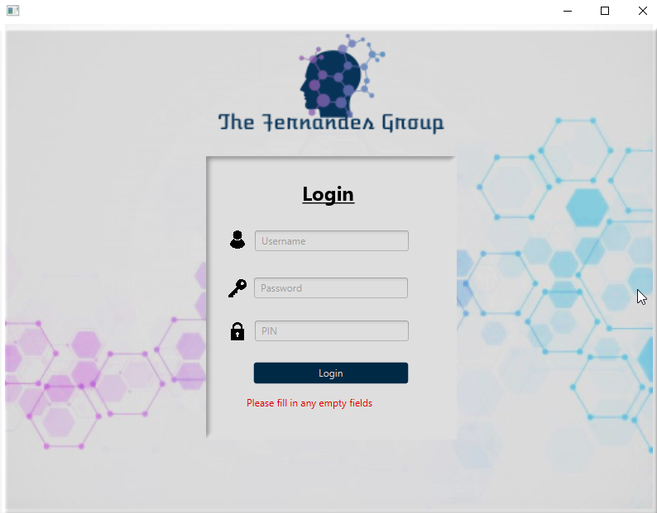
Login Form (empty)
“Please fill in any empty fields” will appear if a user tries to login without having filled the credential boxes

Slide 4
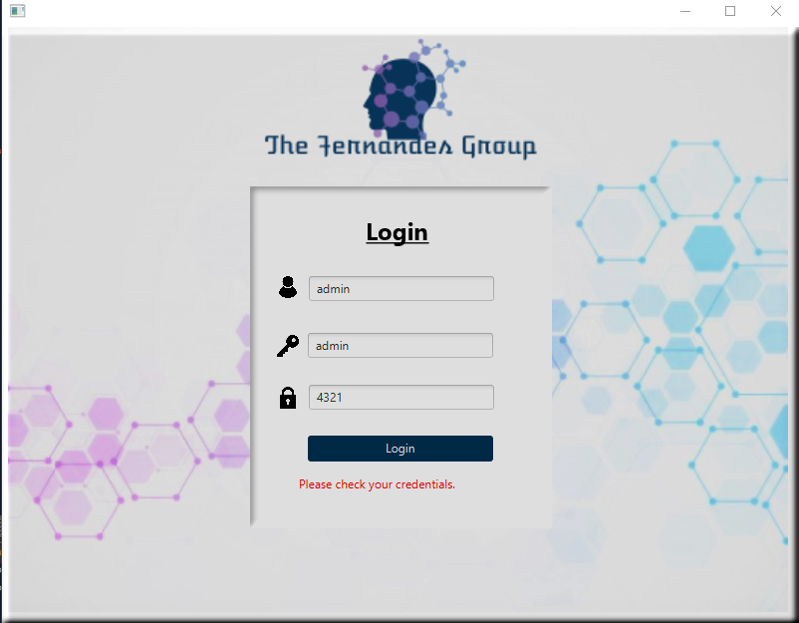
Login Form (error)
“Please check your credentials” will appear if the incorrect login credentials are entered

Slide 5
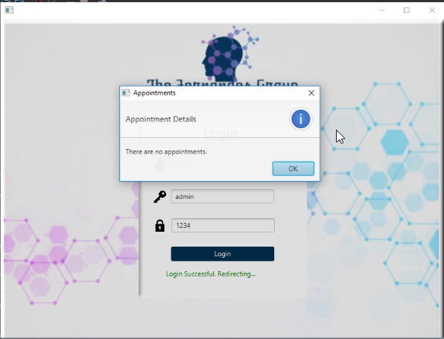
Login Form (Success)
“Login Successful. Redirecting…” will appear when credentials are correct and then transition into the next scene
Appointment alert will show up displaying whether there are appointments within the next 15 minutes

Slide 6
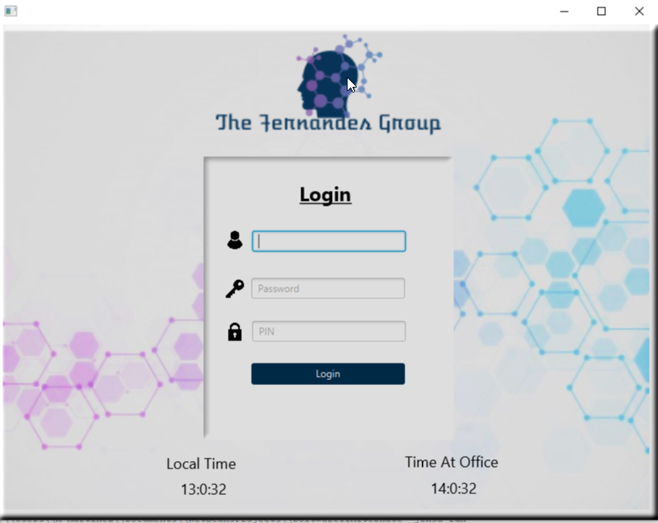
Time
Local time and the office time are now displayed on the login form after running the application

Slide 7

Spanish (time)
Local time and the office time are now are translated in Spanish

Slide 8
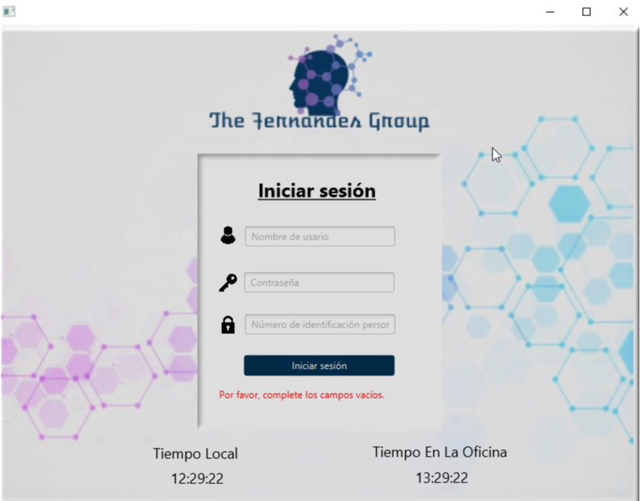
Spanish(empty)
The error label for empty fields is now translated in Spanish

Slide 9
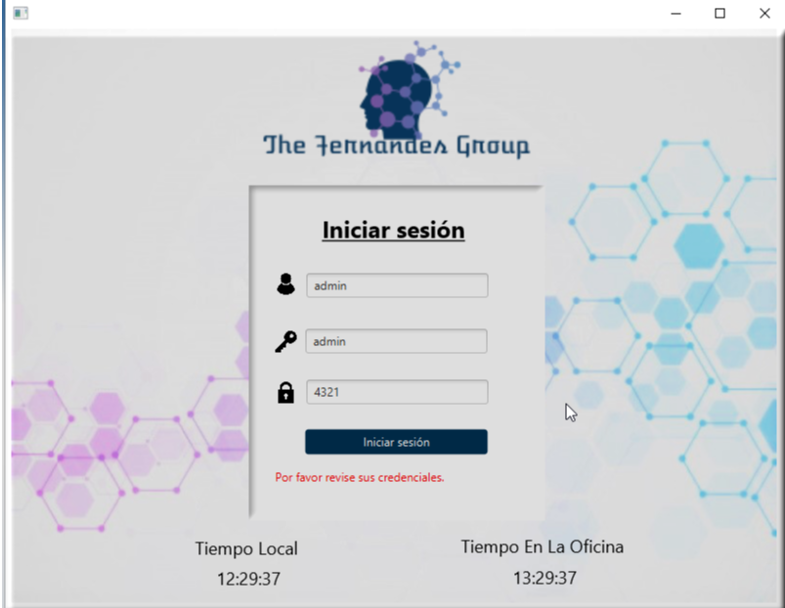
Spanish(incorrect)
The error label for incorrect credentials is now translated in Spanish

Slide 10
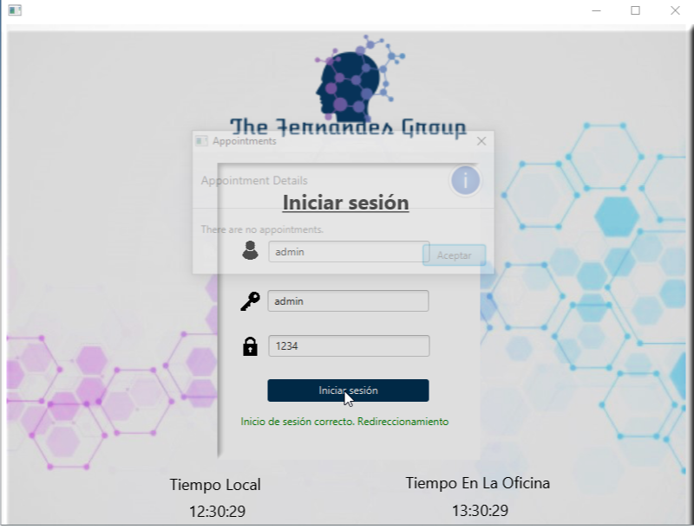
Spanish(success)
The error label for a successful login is now translated in Spanish

Slide 11
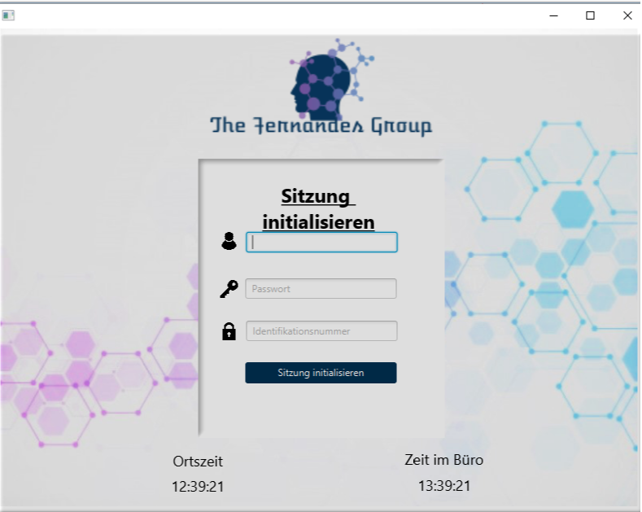
German(Time)
Local time and the office time are now are translated in German

Slide 12
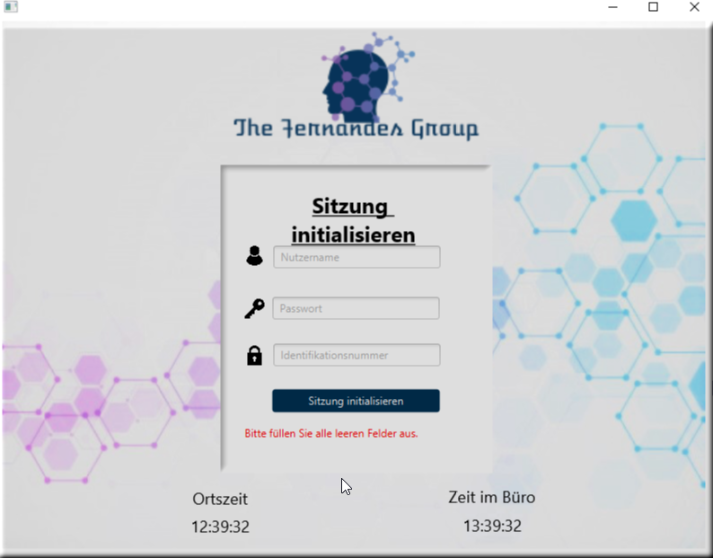
German(Empty)
The error label for empty fields is now translated in German

Slide 13
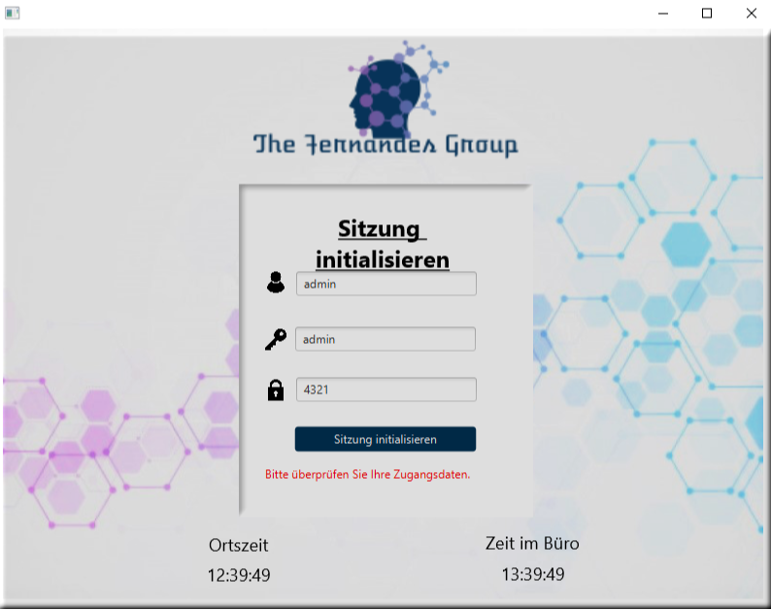
German(Incorrect)
The error label for incorrect credentials is now translated in German

Slide 14
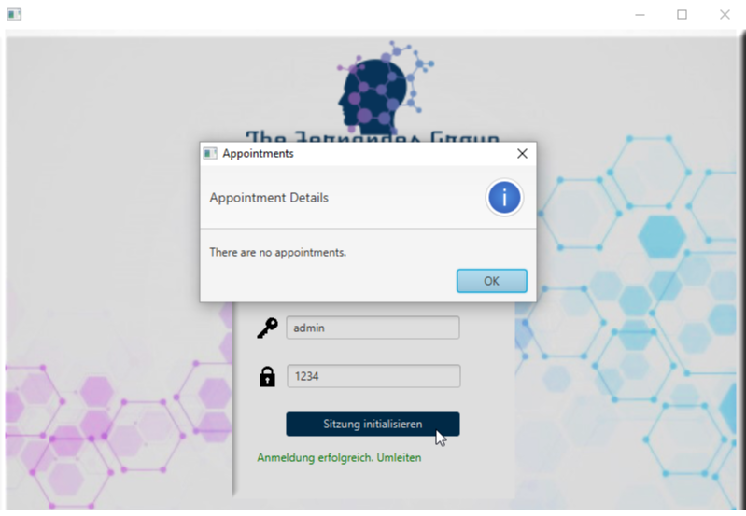
German(Success)
The error label for a successful login is now translated in German

Slide 15
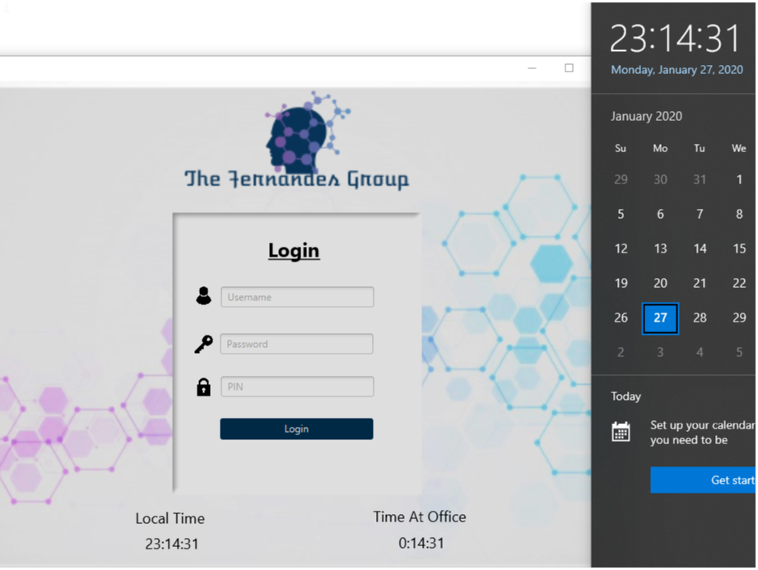
Time Zones (CST:Login)
The Local Time and the Time At Office clocks update according to the system time and the time at the office respectively

Slide 16
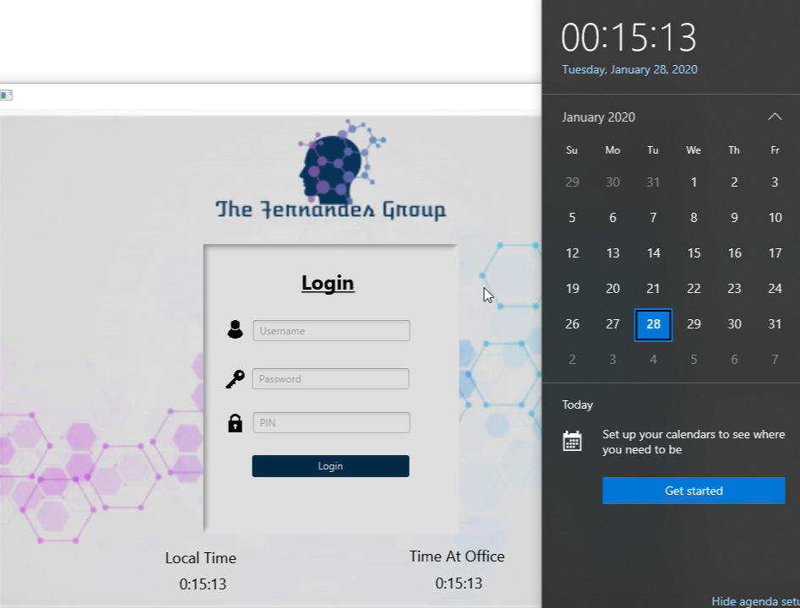
Time Zones (EST:Login)
After changing the system time to EST as opposed to CST (my current time zone) one can see that the clocks for the login form now match

Slide 17
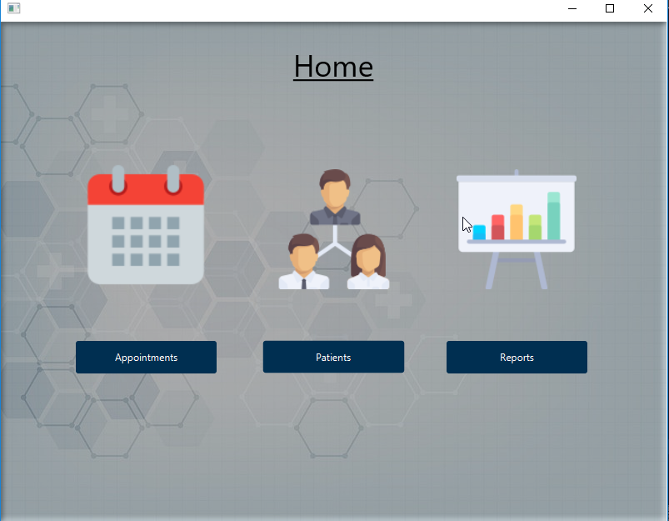
Home Screen
Allows the logged in user to choose whether to view the Appointments, Patients, or Reports

Slide 18
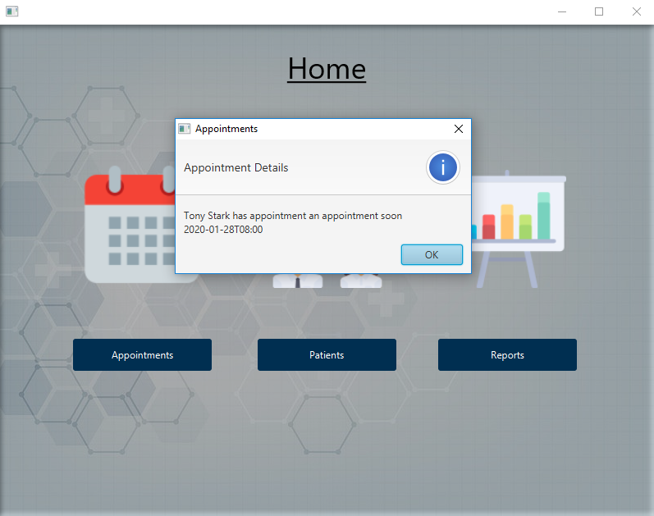
4 – Hour Alert
Appointments within the next 4 hours are now displayed in the proper format

Slide 19
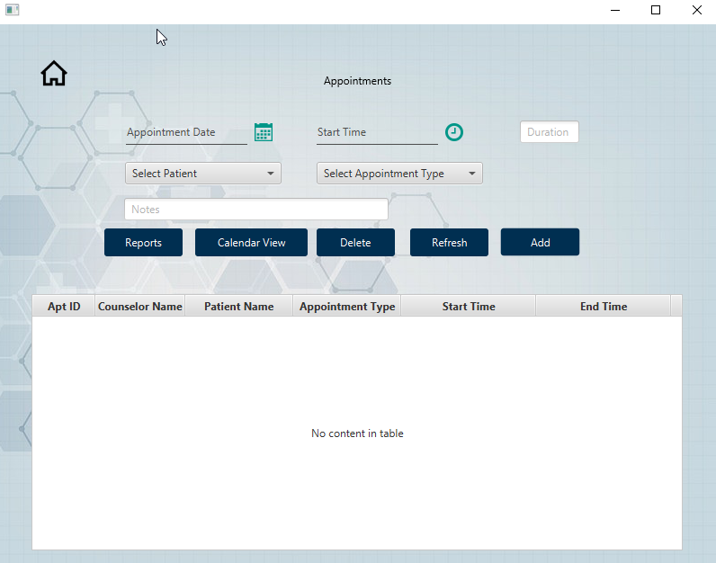
Appointment View
Allows the user to set an appointment date, start time, duration, patient, appointment type, and enter notes
From here, one can add, update or delete appointment records as well as view the reports and appointment calendar

Slide 20
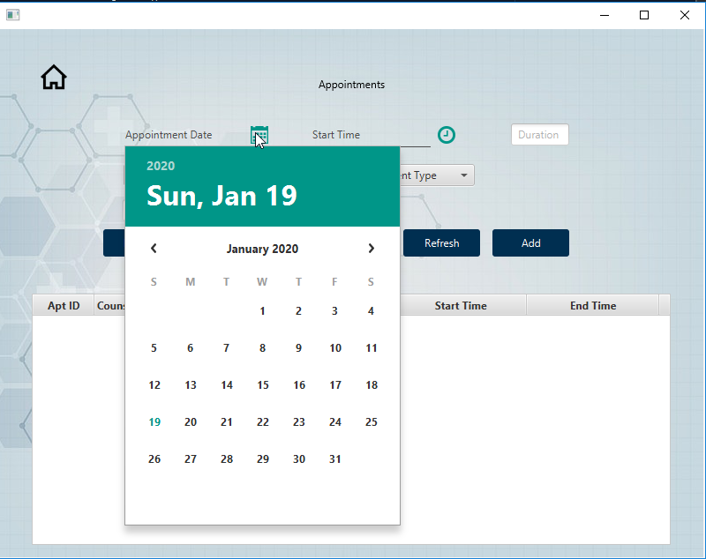
Appointment View (cont.)
Selecting the appointment calendar will show today’s date

Slide 21
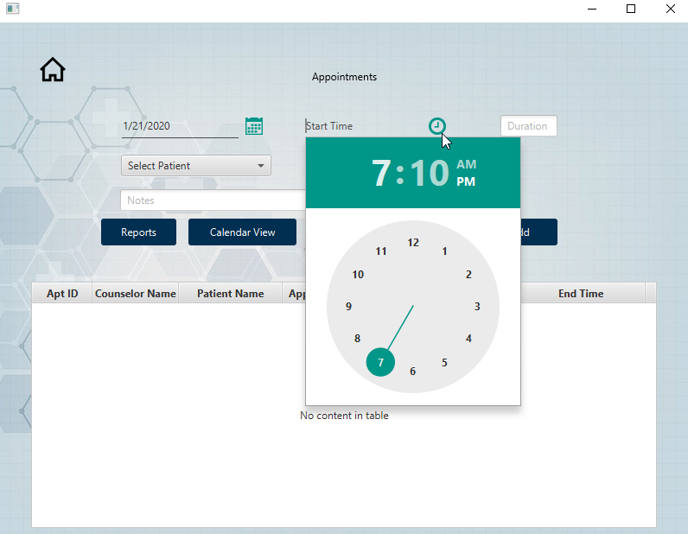
Appointment View (cont.)
Selecting the start time will show the current local time

Slide 22
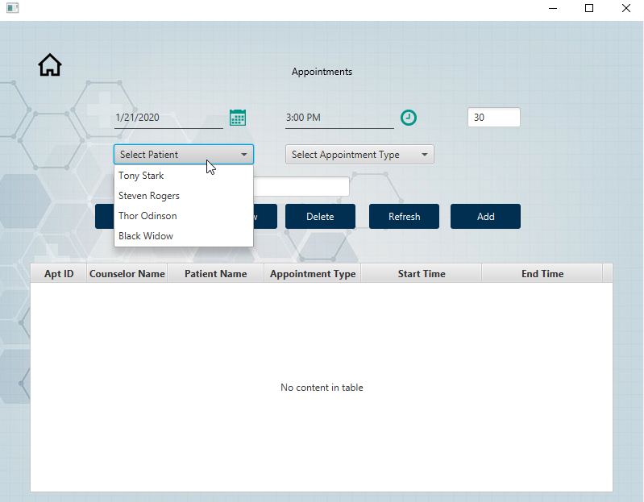
Appointment View (cont.)
The patient dropdown will show the list of patients that are currently in the database

Slide 23
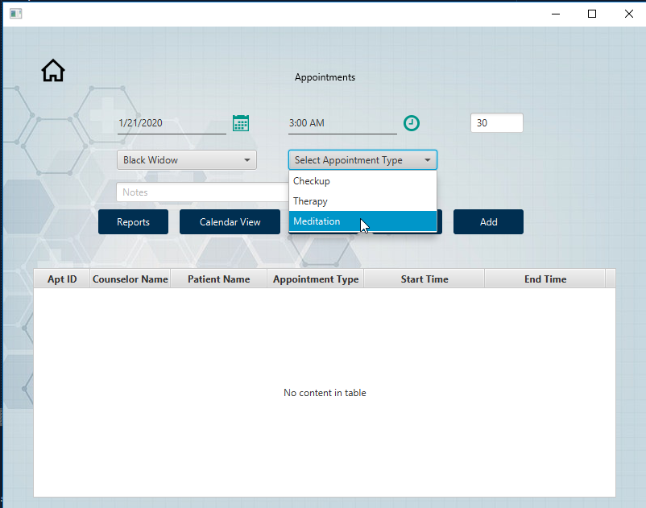
Appointment View (cont.)
The appointment type dropdown will show the list of appointment type available

Slide 24
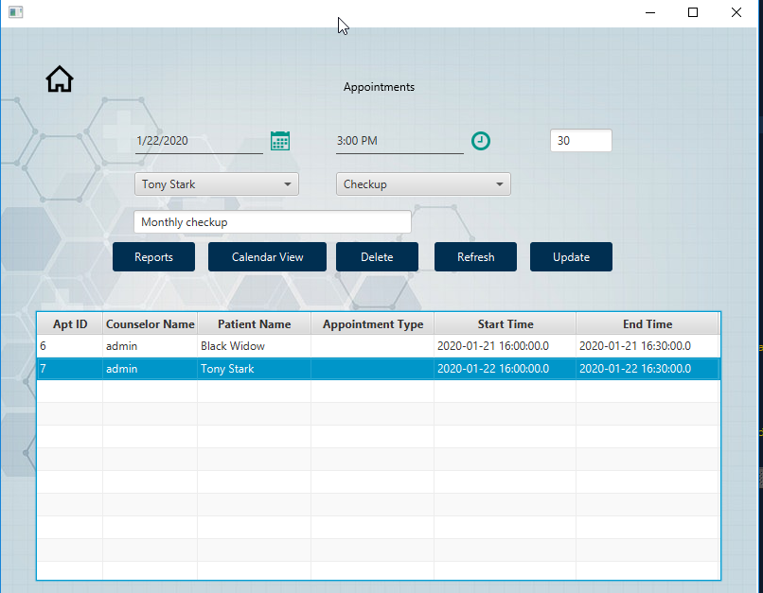
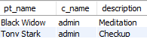
Appointment View (add)
Alert showing that the appointment was added successfully
Table now populates with the data
Ran into issues getting the appointment type to display within the table, however, the database gets updated with the correct appointment type

Slide 25
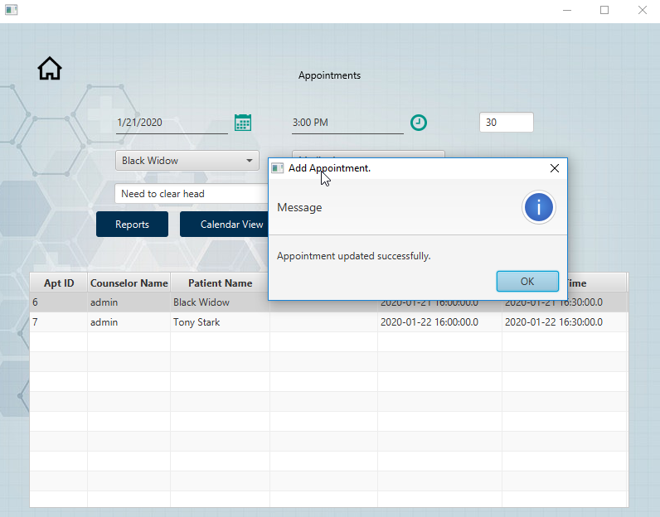
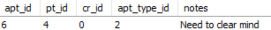
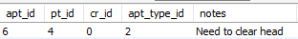
Appointment View (update)
Alert showing that the appointment has been updated successfully

Slide 26
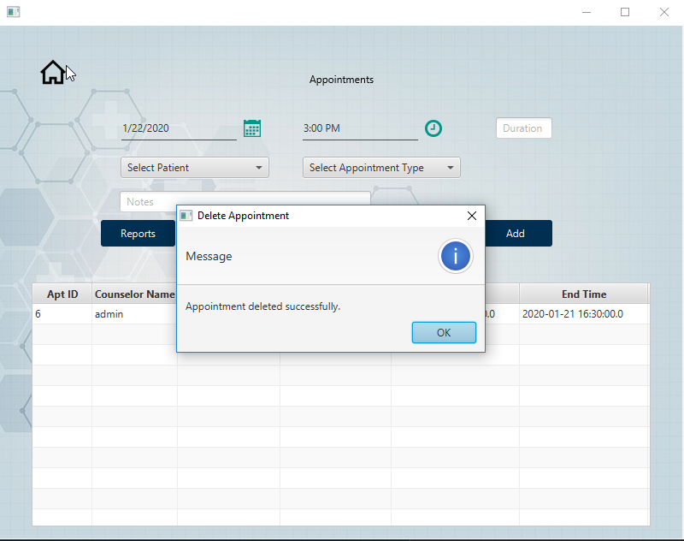
Appointment View (delete)
Alert showing successful deletion of the patient’s appointment record

Slide 27
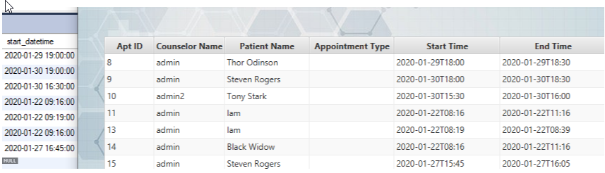
Time Zones (CST:ApptView)
The appointment view has now been updated to display the times to the user according to their system time
Appointment times, however, will remain at EST within the DB
Db Times
Scheduling app times

Slide 28
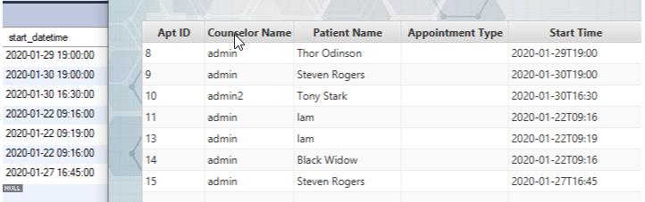
Time Zones (EST:ApptView)
After changing the system time to EST one can see that the appointment times displayed to the user now match the times in the database
Db Times
Scheduling app times

Slide 29
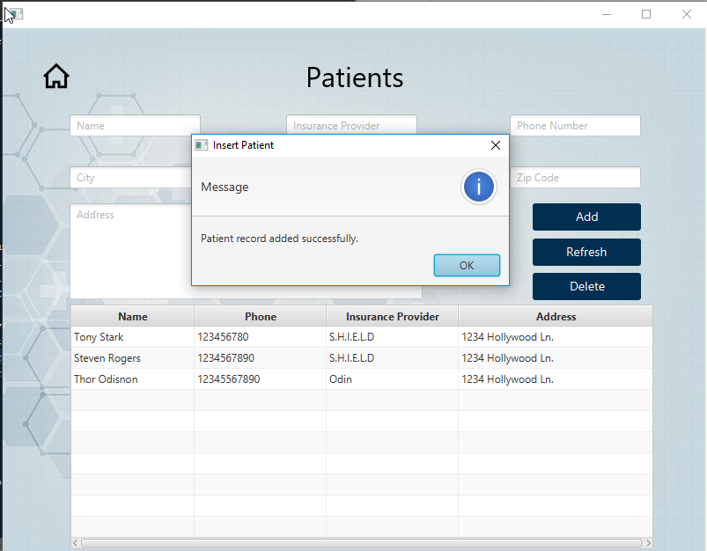
Patient View (add)
Alert letting you know that the patient has been added successfully

Slide 30
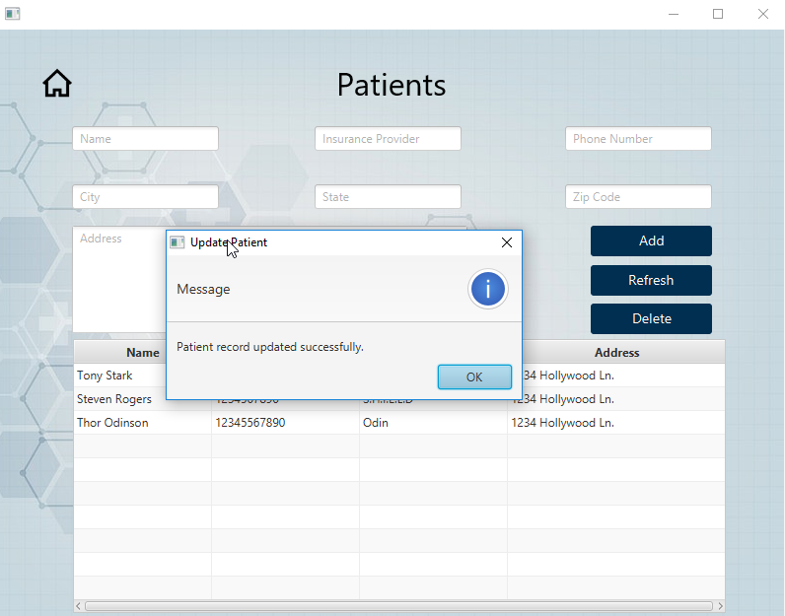
Patient View (update)
Intentionally misspelled “Odinson” in the last slide
Alert comes up letting you know that the record was updated successfully
You can now see that the record

Slide 31
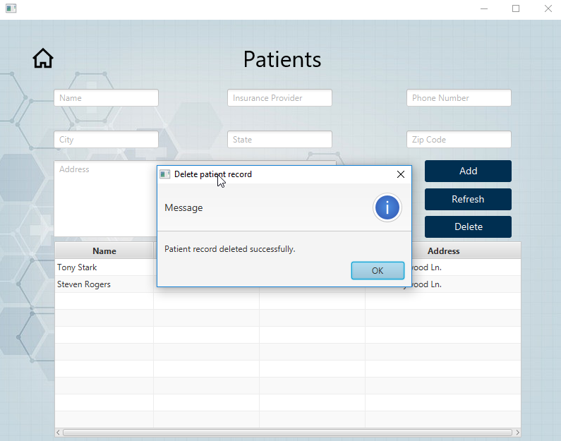
Patient View (delete)
Alert showing that the patient has been deleted successfully

Slide 32
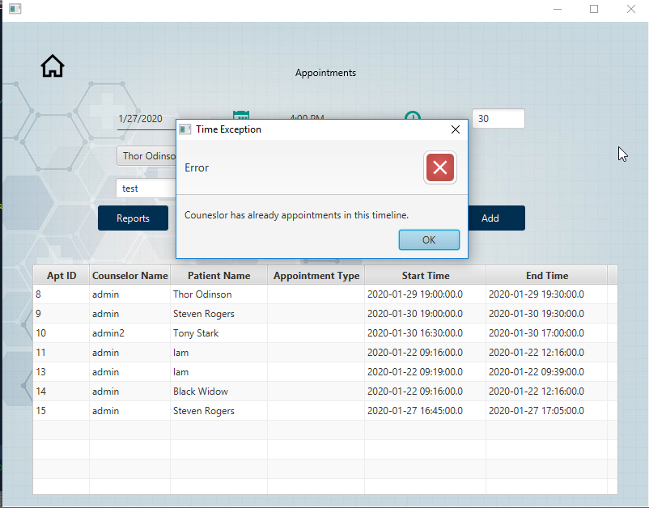
Overlap (counselor)
Overlapping appointments are no longer allowed for the same counselor
Attempted to add an appointment for Thor Odinson at 4:00 PM CST on 1/27/2020

Slide 33
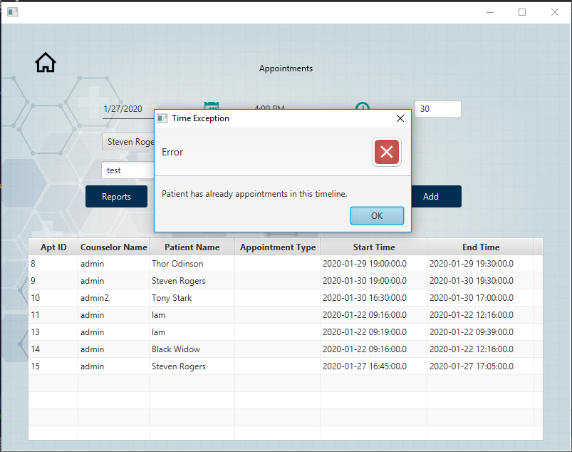
Overlap (patient)
Overlapping appointments are no longer allowed for the same patient
Logged in as the second counselor (admin2) and attempted to add an appointment for Steven Rogers at 4:00 PM CST on 1/27/2020

Slide 34
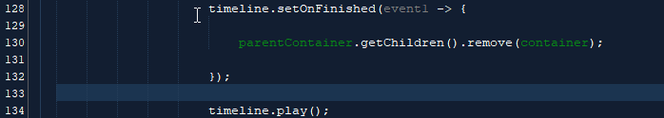
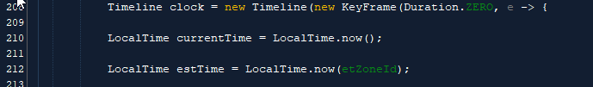
Lambda Expressions
I used both of these expressions within LoginFormController.java
My justification for using the lamda expressions is so that I wouldn’t have to use separate classes in order to implement the interfaces
The added benefit is that it makes the code more concise, readable, and reusable

Slide 35
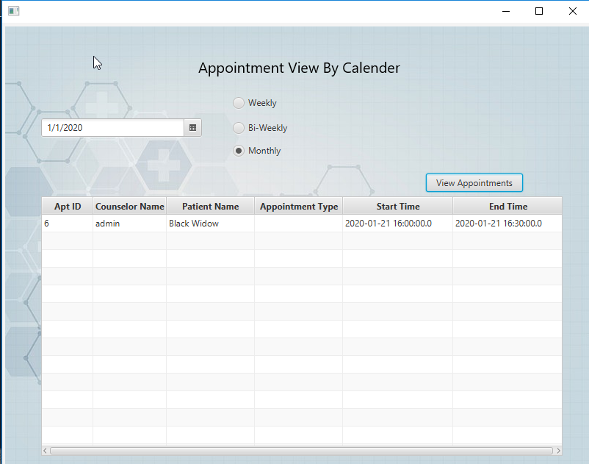
Calendar View
Allows the user to view the list of appointments either weekly, bi-weekly, or monthly from the selected date

Slide 36
Reports
Allows the user to view the list of appointments either weekly, bi-weekly, or monthly from the selected date

Slide 37
Reports
Allows the user to view the list of appointments either weekly, bi-weekly, or monthly from the selected date

Slide 38
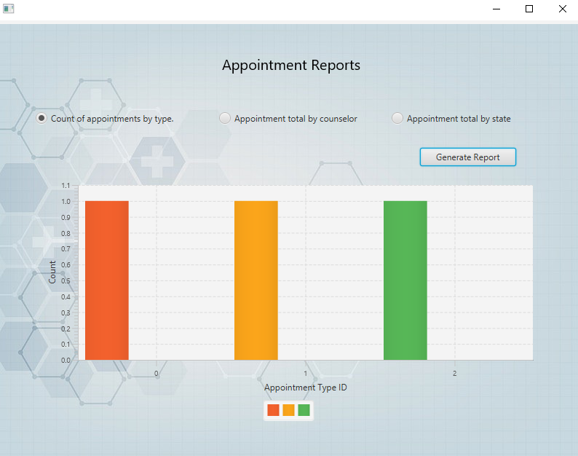
Reports (type)
Appointment by type report

Slide 39
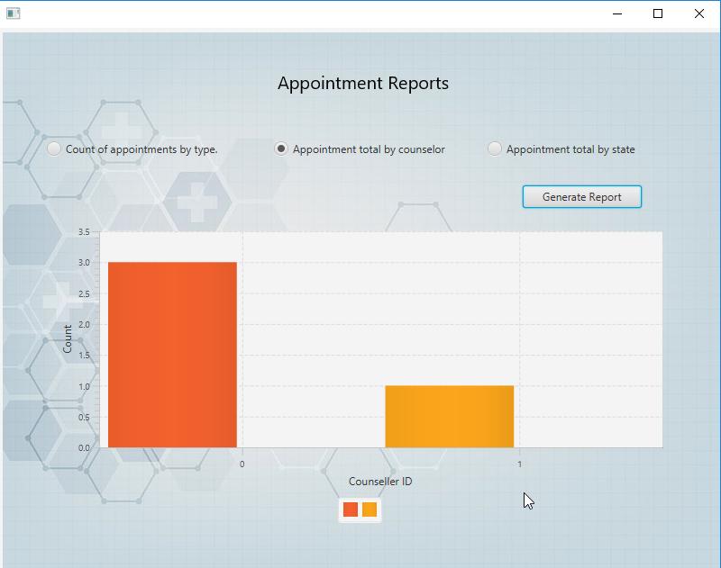
Reports (counselor)
Appointment by counselor report

Slide 40
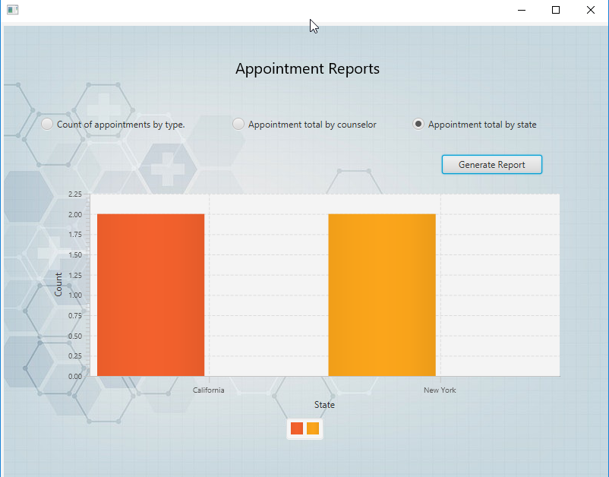
Reports (state)
Appointment by state report

Slide 41
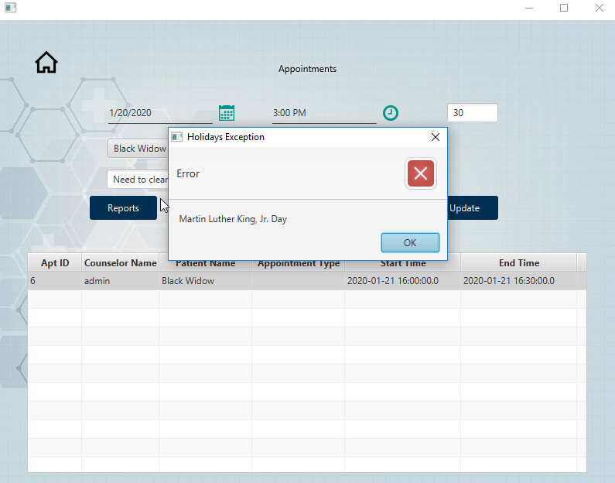
Holiday Exception (MLK)
MLK Exception

Slide 42
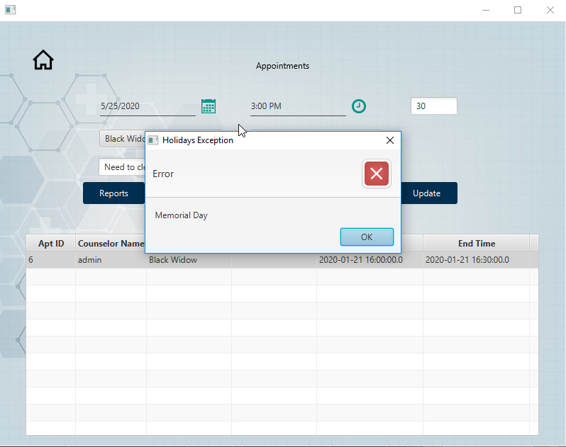
Holiday Exception (Memorial Day )
Memorial Day exception

Slide 43
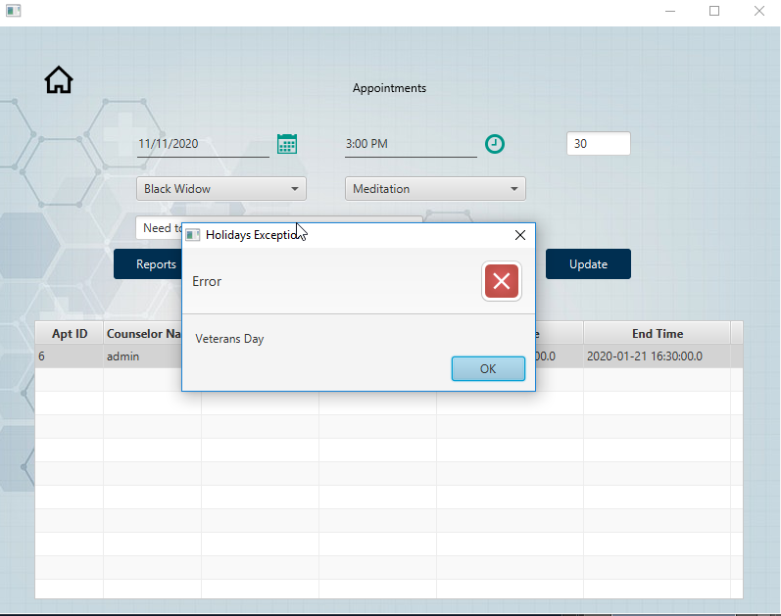
Holiday Exception (Veteran’s Day)
Veteran’s Day exception

Slide 44
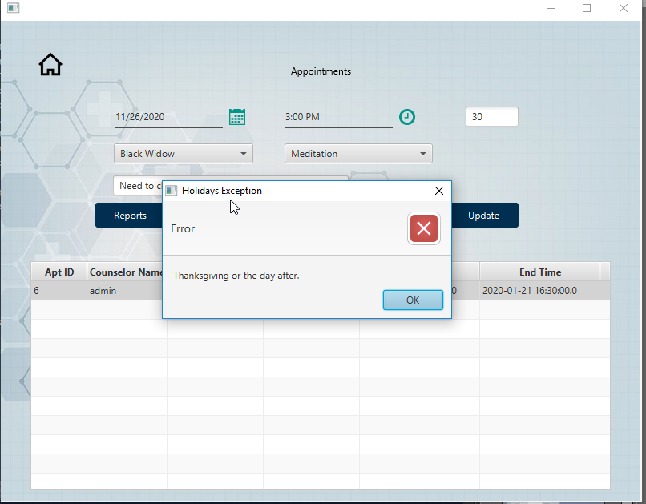
Holiday Exception (Thanksgiving)
Thanksgiving & the day after exception

Slide 45
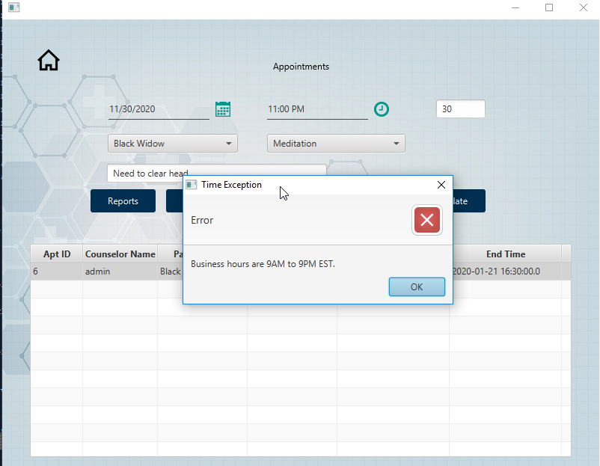
Business Hours Exception
Unable to add appointments outside of business hours

Slide 46
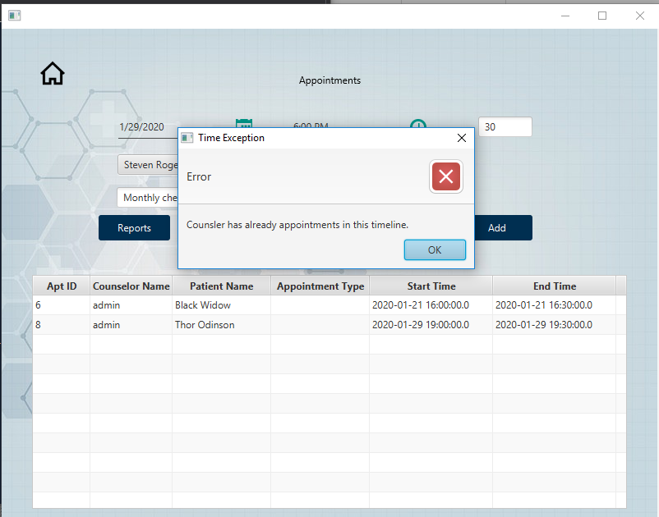
Counselor Exception
Counselor appointment overlap

Slide 47
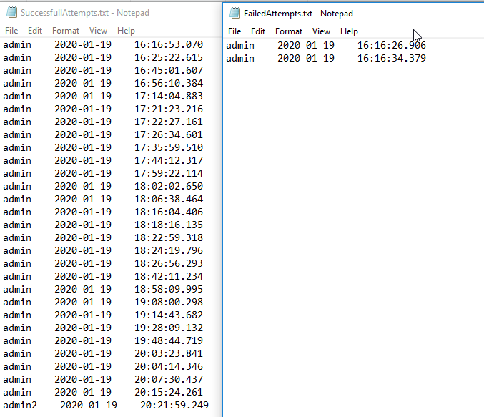
Login Attempts
Stored in folder called LoginTracker

